Slide 1
Draft HSWC presentation

Slide 2
GitHub repo & README
Rationale for Project Selection
To help animal control efforts locally in Waupaca county by historical data analysis to assist in obtaining grant funding to help cover the cost for spay and neuter procedures of low income family pets and free roaming cats.
Source Data
6 .csv files for 2018, 2019 and 2020 obtained from the Waupaca County Humane Society.
3 files with spay and neuter data for each year
3 files with stray and surrender details for each year

Slide 3
GitHub & README continued
Questions to Answer
What is the need for future spay and neuter funding for the Waupaca County Humane Society?
The answer to this question will be used by the Waupaca County Humane Society to request grant funding for future spay and neuter surgical procedures.
Communication Protocols
Slack group for quick communication and sharing of ideas and files.
Scheduled and impromptu Zoom meetings to discuss project progression and planning for future tasks and completion deadlines.

Slide 4
Explanation of ML model
ARIMA (AutoRegressive Integrated Moving Average) Model will be used.
This model will take historical data of spay and neuters conducted by the Waupaca Humane Society and train the ML model to predict future needs for spays and neuters to request grant funding.

Slide 5
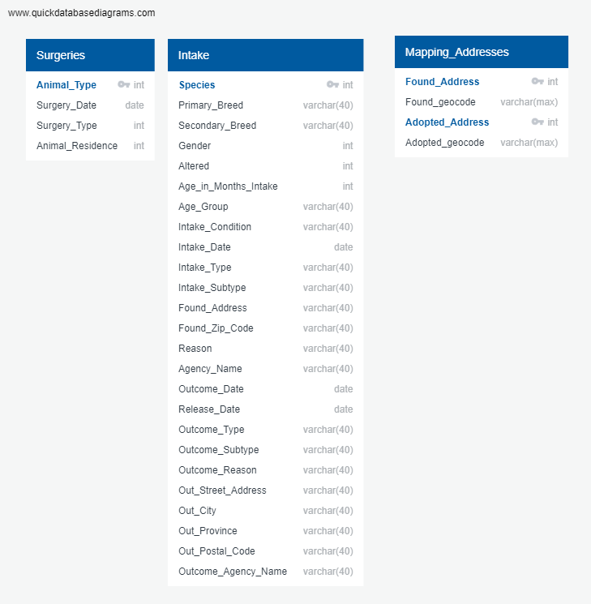
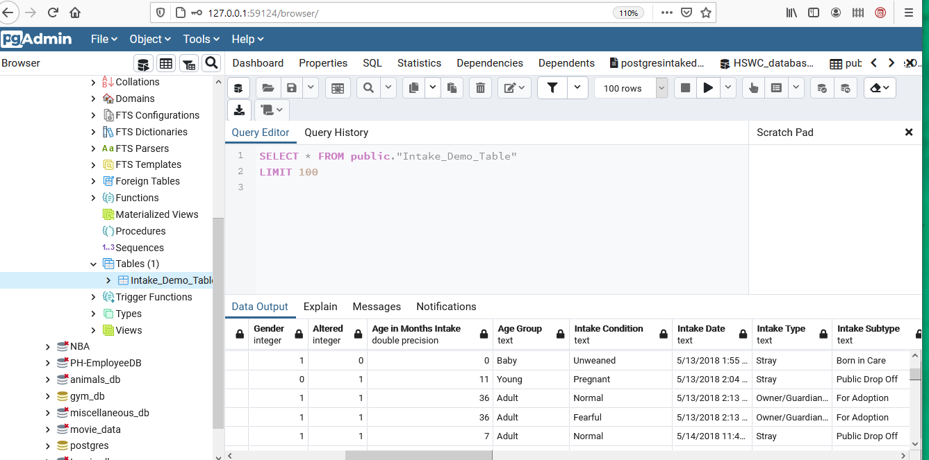
Database

Slide 6
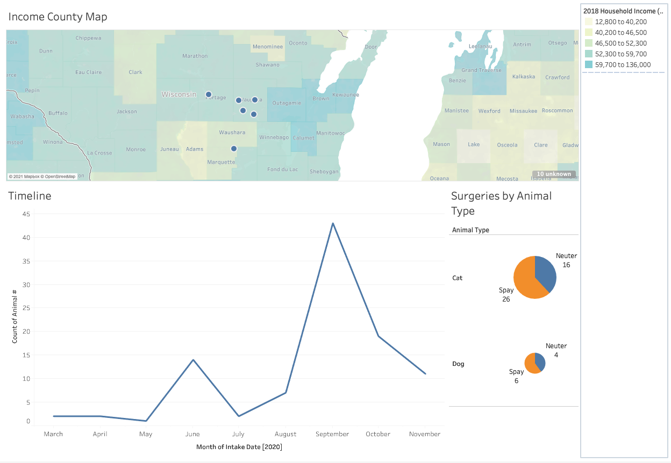
Blueprint of Tableau Dashboard
This is a representation of what our dashboard would like. Our charts will be group into zones that are closely related to each other, so we can get a more coherent picture of our story.
This arrangement will depends on what questions we are answering with our dataset.

Slide 7
May 30th milestones
All preprocessing of data complete
AWS database set up
ML model switched, new model demo
Mockup dashboard

